Slide 1
Unit 3 Objectives
At the end of this lesson, you should be able to:
  Define resource typing and describe its purpose.
  Describe qualification, certification and credentialing of personnel.
  Identify the importance of training and exercising resource capabilities prior to an incident.

Slide 2
Resource Management: Preparedness Activities
In the last lesson we discussed identifying, planning for and acquiring, storing and inventorying resources. In this lesson we will examine two additional resource management preparedness activities:
  Typing Resources: Assigning a standardized typing designation to each resource that allows Incident Commanders to request and deploy resources.
  Qualifying, Certifying and Credentialing Personnel: Ensuring personnel meet common standards that provide a foundation for mutual aid requests.
Additionally, in this lesson we will explore Training and Exercising as methods to support readiness, interoperability and compatibility of resources.
The next screen introduces resource typing.

Slide 3

Introduction to Resource Typing

Slide 4
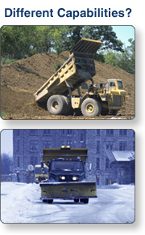
Resource Typing Overview (Screen 1 of 2)
Resource typing is the categorization, by capability, of the resources requested, deployed, and used in incidents. Measurable definitions identifying the characteristics and capabilities for resources serve as the basis for typing.
  Capability: The core capability for which the resource is most useful
  Category: The function for which a resource would be most useful (e.g., firefighting, law enforcement, health and medical)
  Kind: A broad characterization, such as personnel, teams, facilities, equipment and supplies
  Type: A resource’s level of minimum capability to perform its function
Resource typing is a continuous process designed to be as simple as possible to facilitate frequent use and accuracy in obtaining needed resources. For example, a construction dump truck and a dump truck with a snow plow have different capabilities, capacities, and purposes. They would, therefore, be of different types.

Slide 5
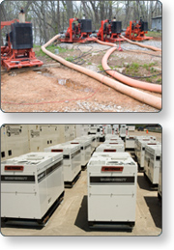
Resource Typing Overview (Screen 2 of 2)
The FEMA National Preparedness Directorate (NPD) has identified, promoted, and published resource typing definitions for the most commonly requested interstate resources. Resource typing definitions provide information to emergency managers and response personnel to ensure that they request and receive the appropriate resources.
For example, resource typing definitions help ensure that generators used for pumping water are not sent to fill a request for generators that provide electricity to buildings.
NIMS encourages States, tribes, and local governments to use the national resource typing definitions to define their response assets.
Jurisdictions can identify and inventory deployable incident resources consistently with national NIMS resource typing definitions and job titles/position qualifications, available through the Resource Typing Library Tool at this website: http://www.fema.gov/resource-management-mutual-aid.

Slide 6
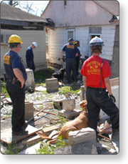
National Resource Typing Definitions
At the national level, FEMA leads the development and maintenance of NIMS resource typing definitions that are national in scope.
States should inventory their assets to determine if national resource types are in the State. If they are, the State should maintain an inventory of these national resource types for use in the event of an incident. States that do not have any national resource types in their inventories are not required to purchase them.
Urban search and rescue task forces are an example of a resource that is national in scope and should be inventoried.
These NIMS resource typing definitions can serve as a useful guide for States when developing their own definitions for resource types that are not included in the NIMS resource typing definitions.

Slide 7
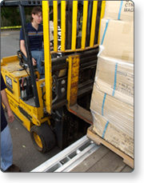
Typing Resources That Are Not National in Scope
State, territorial, tribal and local governments should also type and inventory their assets that are not national in scope.
Typing and inventorying these resources makes resource sharing under mutual aid agreements and compacts more efficient.
Fork lifts are an example of a resource that is not national in scope and does not have a NIMS resource typing definition in the Resource Typing Library Tool.

Slide 8
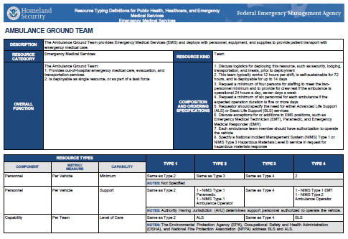
NIMS Resource Type Definitions
Resources are categorized by resource type definition. Emergency management and Response personnel can use these definitions to inventory their resources.
NIMS resource type definitions use the resource characteristics Capability, Category, Kind and Type.
Capability is the core capability for which the resource is most useful (32 core capabilities are outlined in the National Preparedness Goal).
Category is the function for which a resource would be most useful (firefighting, law enforcement, medical, etc...).
Kind is the broad classes that characterize like resources (personnel, teams, facilities, equipment and supplies).
Type is a resource's level of minimum capability to perform its function.
  A resource’s type is determined based on the kind of resource and mission. For example a mobile kitchen unit is typed according to the number of meals it can produce, while dump trucks are typed according to haul capacity.
  The resource type includes capability level of 1-4. Type 1 is the highest capability and type 4 is the least.
  The level of capability is based on size, power, and capacity (for equipment) or experience and qualifications (for personnel or teams).

Slide 9

Implementing Resource Typing
Jurisdictions must be working to achieve the NIMS implementation in order to qualify for FEMA federal preparedness (non-disaster) grant awards.
Included in the NIMS Implementation objectives is the identification and inventory of deployable incident resources consistent with national NIMS resource typing definitions and job titles/position qualifications.
These resource definitions and position qualifications are available through the Resource Typing Library Tool. dentification and inventory of deployable incident resources consistent with national NIMS resource typing definitions and job titles/position qualifications.
These resource definitions and position qualifications are available through the Resource Typing Library Tool.
These resource definitions and position qualifications are available through the Resource Typing Library Tool. These resource definitions and position qualifications are available through the Resource Typing Library Tool.

Slide 10
Jurisdictional Resource Typing Definitions
If FEMA does not have an established resource typing definition for a resource that a jurisdiction uses and shares, the jurisdiction may develop its own resource typing definition. Jurisdiction staff should involve subject matter experts and other stakeholders to help define the minimum capabilities for the resource. Jurisdictions should also consider the following:
  Resource typing definitions apply to deployable resources: The point of typing resources is to ensure that resource providers and requestors have consistent expectations of a resource's capability levels. If the resource will not support incident operations outside its own jurisdiction, typing the resource may not be beneficial.
  Focus on capabilities: Resource typing definitions are intended to be guidelines for minimum capabilities.
  Do not create resource typing definitions that conflict with NIMS resource typing definitions: Creating new resource types that conflict with NIMS resource typing definitions undermines the value of the standardized national system. Jurisdictions should create new resource typing definitions only if they do not conflict with NIMS definitions.
If a jurisdiction establishes its own resource typing definition, it should share that definition with FEMA and mutual aid partners to promote common language and understanding of the resource's capabilities and to facilitate planning and future resource sharing. FEMA may also consider that resource type for inclusion in the NIMS resource typing definitions.

Slide 11

Information Management Systems
Information Management Systems are used to:
  Collect, update, and process data
  Track resources
  Display their readiness status
These tools enhance information flow and provide real-time data in a fast-paced environment where different jurisdictions and functional agencies are managing different aspects of the incident life cycle and must coordinate their efforts. Examples include:
  Geographical information systems (GISs)
  Resource tracking systems
  Transportation tracking systems
  Inventory management systems
  Reporting systems

Slide 12
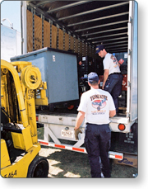
Equipment Preparedness
Two best practices for resource management preparedness are:
  Acquiring equipment that will perform to certain standards (as designated by organizations such as the National Fire Protection Association or National Institute of Standards and Technology), including the capability to be interoperable with equipment used by other jurisdictions or participating organizations.
  Developing a common understanding of the capabilities of distinct types of equipment, to allow for better planning before an incident and rapid scaling and flexibility in meeting the needs of an incident.

Slide 13
Lessons Learned: Resource Management Example
In 1991 the City of Oakland, California, suffered a major conflagration in which hundreds of homes were lost and millions of dollars in damages were incurred. A major contributor to the problem was equipment incompatibility. The City of Oakland had water hydrant connections that did not meet the national standard. While the City had a special dispensation to use 2" rather than 2.5" connections, the difference meant that some mutual aid fire engines did not carry adaptors and could not access the city water supply. When the fire began, close-in, mutual aid engines that had adaptors were quickly depleted, and the City of Oakland did not have enough additional adaptors to equip the number of engines that responded from outside the immediate mutual aid area. This is an extreme example of the need for a standardized approach to emergency resource management. One of the primary goals of the National Incident Management System is to identify and establish the essential concepts and principles of resource management that will be covered in this course.

Slide 14
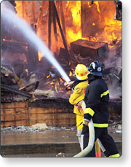
Interoperability
The NIMS Guiding Principle of Standardization is essential to interoperability.
No jurisdiction has all of the resources that could conceivably be needed during a major incident. Interoperable resources can be moved and assigned across jurisdictional boundaries. This expands the resource pool and increases the likelihood of an effective response.
Strategies to ensure interoperability include:
  Where national standards exist for connections, fittings, and hardware, these should be adopted by all jurisdictions.
  When possible, combine orders for standardized equipment.
  Where possible, make collective bulk orders to help ensure both best price and interoperability.

Slide 15

Communications Issues
Interoperability may be a major issue with communications equipment.
Interoperability does not necessarily require matching hardware, but it must be compatible. 800 or 900 MHz systems may be proprietary, making communication with others who are not registered users on the system more difficult.
It is important to ensure that agencies share enough frequencies to provide communication during incidents. Many States have established statewide emergency frequencies that can be used for major mobilizations.
Some other issues with communications equipment are backup power and redundancy, as well as alternative communication methods for alert and warning systems.

Slide 16
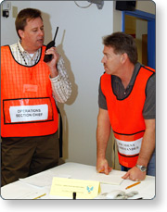
Standard Operating Procedures
Consideration should be given to coordinating standard operating procedures (SOPs) where they might affect how a resource can be deployed.
For example, law enforcement agencies have different policies and procedures on issues such as restrictions on the use of arrest authorities. Where possible, mutual aid partners should agree on such policies. When policies and procedures cannot be reconciled, it is important that mutual aid partners know the differences up front.

Slide 17

Testing Interoperability
Short of actual incident activation, the final test of all planning activities is to assess whether or not equipment and systems work under simulated conditions.
Testing equipment and systems should be incorporated into training and comprehensive exercises.

Slide 18

Personnel Qualifications and Certification
Qualifying, certifying, and credentialing are the essential steps, led by an Authority Having Jurisdiction (AHJ), that help ensure that personnel deploying through mutual aid agreements have the knowledge, experience, training, and capability to perform the duties of their assigned roles.
These steps help to ensure that personnel across the Nation are prepared to perform their incident responsibilities based on criteria that are standard nationwide.
Qualification is the process through which personnel meet the minimum established criteria—training, experience, physical and medical fitness, and capability—to fill specific positions.
Certification/Recertification is the recognition from the AHJ or a third party7 stating that an individual has met and continues to meet established criteria and is qualified for a specific position.

Slide 19
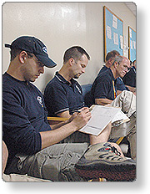
Credentialing
Credentialing occurs when an AHJ or third party provides documentation—typically an identification card or badge—that identifies personnel and authenticates and verifies their qualification for a particular position. While credentialing includes issuing credentials such as identification cards, it is separate from an incident-specific badging process, which includes identity verification, qualification, and deployment authorization.
Certain positions require third-party certification and/or credentialing from an accredited body such as a state licensure board for medical professionals.
Credentialing is separate from badging, which takes place at the incident site in order to control access.

Slide 20
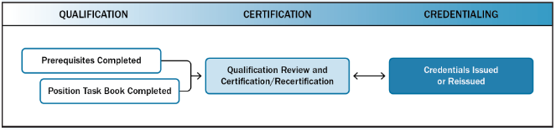
Credentialing Process
The NIMS qualification, certification, and credentialing process uses a performance-based approach. This process enables communities to plan for, request, and have confidence in personnel assigned from other organizations through mutual aid agreements.
Nationally standardized criteria and minimum qualifications for positions provide a consistent baseline for qualifying and credentialing the incident workforce. Along with the job title and position qualifications, the position task book (PTB) is a basic tool that underpins the NIMS performance-based qualification process. PTBs describe the minimum competencies, behaviors, and tasks necessary to be qualified for a position. PTBs provide the basis for a qualification, certification, and credentialing process that is standard nationwide.
FEMA recommends minimum qualifications, but it is AHJs across the Nation that establish, communicate, and administer the qualification and credentialing process for individuals seeking qualification for positions under that AHJ’s purview. AHJs have the authority and responsibility to develop, implement, maintain, and oversee the qualification, certification, and credentialing process within their organization or jurisdiction. AHJs may impose additional requirements outside of NIMS for local needs. In some cases, the AHJ may support multiple disciplines that collaborate as a part of a team (e.g., an Incident Management Team [IMT]).
As a part of the National Qualification System (NQS), FEMA also has developed NIMS Job Titles/Position Qualifications and accompanying Position Task Books (PTB), and the NIMS Guideline for Mutual Aid which you can access at https://www.fema.gov/national-qualification-system

Slide 21
Discussion Question - Credentialing
What are the advantages of credentialing?

Slide 22

Training
Qualification has a training component. All incident personnel should receive the appropriate training to perform in their assigned incident roles.
The term incident personnel includes all individuals who have roles in incident management or support, whether on scene, in an EOC, or participating in a MAC Group.
Not all training occurs in a classroom. The best approach to a training need will vary based on the skills and capabilities to be acquired and may include:
  Self-study or Web-based courses
  Classroom instruction
  Experience based training under a mentor during incidents or exercises
  Observing others perform a task by observing or "shadowing" experienced practitioners during incidents or exercises
The NIMS Training Program provides guidance for organizations and jurisdictions in the development of their training plans. https://www.fema.gov/training-0

Slide 23
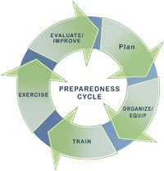
Exercises
Exercises bring together and strengthen the whole community in its efforts to prevent, protect against, mitigate, respond to, and recover from all hazards.
Exercises that employ interoperable systems, equipment and personnel enable jurisdictions and organizations to understand their capabilities and limitations before an incident.
Exercises enable preparedness by testing and validating plans and capabilities, and identifying capability gaps and areas for improvement.
For personnel qualification, exercises can be a venue to develop competency in position specific competencies, behaviors and tasks.

Slide 24
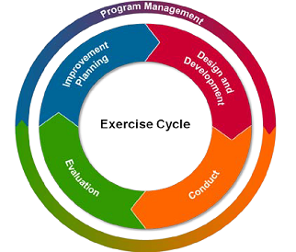
Homeland Security Exercise and Evaluation Program
The Homeland Security Exercise and Evaluation Program (HSEEP) provides a set of guiding principles for exercise programs, as well as a common approach to exercise program management, design and development, conduct, evaluation, and improvement planning.
HSEEP exercise and evaluation doctrine is flexible, adaptable, and is for use by stakeholders across the whole community and is applicable for exercises across all mission areas – prevention, protection, mitigation, response, and recovery.
To learn more about HSEEP: https://www.fema.gov/media-library/assets/documents/32326

Slide 25
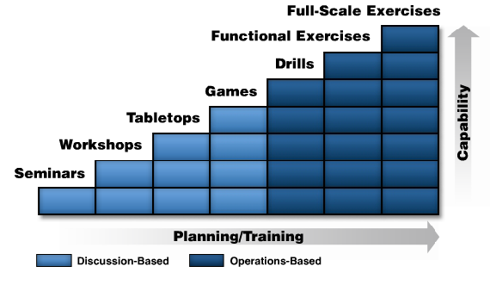
Continuum of Exercises
The diagram below depicts the continuum from discussion-based to operations-based exercises. As the level of capabilities exercised is increased, the commitment needed for planning and training time also increases. The HSEEP provides in-depth information on these various types of exercises.

Slide 26

Activity: Assessing Readiness
Instructions:
  Review the Resource Management Annex to your jurisdictions Emergency Operations Plan (EOP). (Note: If you do not have a copy of your jurisdiction’s annex, use the sample provided at the end of this unit.)
  Complete the checklist on the next page in your Student Manual to assess your jurisdiction’s resource management capability.
  Be prepared to discuss your assessment with the class in 15 minutes.

